Slide 1
LFB Real-Time Data Analytics System
Problem Statement:
Process LFB data in real-time with minimal latency.
GOAL: Produce, Aggregate and Consume aggregated data in near real time using Real-time Streaming and NoSQL Databases.
Created by- Prashant Shukla
Email: prashant_978737@yahoo.co.in

Slide 2
Assumptions
Source data is in local storage as csv.gz (zipped single file).
Robust data schema ensuring consistency.
Analytics scope is limited as defined in assignment project. Hence, some of the csv columns are dropped by the producer itself.
Data is limited to only region i.e. London. Therefore volume is in known limits.

Slide 3
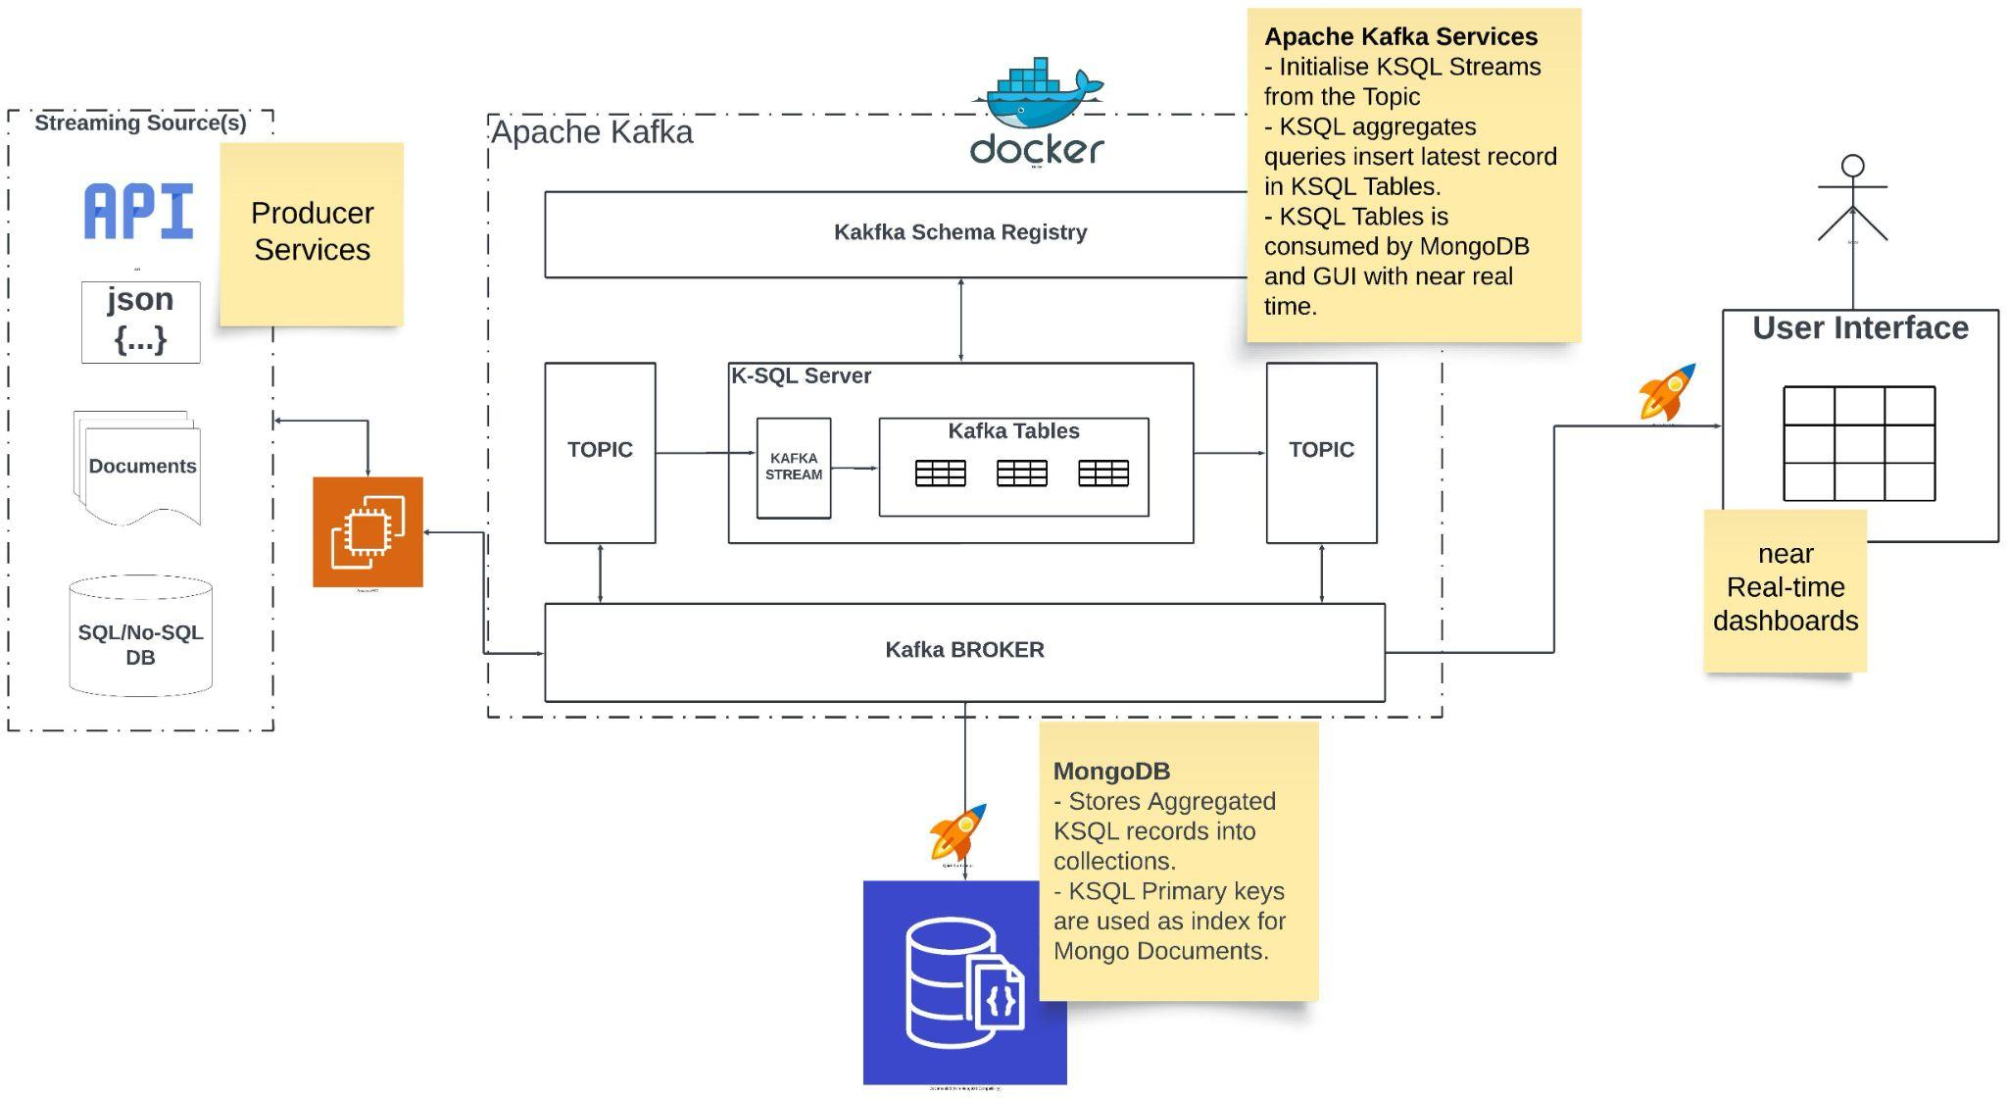
High-level architecture

Slide 4
Why Kafka, K-SQL & Mongo?
Kafka:
Open source, rich libraries, available for popular languages like java and python, huge developer community, widely used data streaming solution.
Easy management of Producer/Consumer- Consumer group load balancing.
Easy to scale- for ex: multiple brokers in a single kafka cluster.
Additionally, Kafka Connect can also be used quickly to produce or consume.
K-SQL (Streams and Tables):
Stream can process and aggregate the events on topic in real-time.
Tables can capture current state of the stream records.
Tables automatically assigns the primary keys based on group by fields, which reduces the insert/update process for downstreams.
K-SQL feature like- WINDOW, PARTITIONS etc can perform data processing based on intervals and much more.
Tables can be consumed directly by the databases or GUI services.
MongoDB:
MongoDB is sufficient to deal with Write heavy tasks.
If Read traffic increases, scaling read replicas is easy and can manage sudden increase of load.
P.S. Biased MongoDB User

Slide 5
Thank you!

